Slide 1
Exam 2 Review
Floating Point Arithmetic, MIPS Assembly, MIPS Single Cycle Datapath

Slide 2
Notes
5 questions total
Materials
Pen/Pencil
A non-graphing calculator is permitted

Slide 3
Floating Point Arithmetic
Floating Point representation
IEEE 754
Single Precision vs. Double Precision
Biased Exponents
Floating Point Arithmetic
Add/Subtract
Multiply/Divide
Notes:
Learn all floating point algs

Slide 4
Sample Question
Convert 220.2 * 2⁻¹¹⁸ (base 10) to IEEE-754 single precision floating point format.

Slide 5
Sample Question
Use the FP multiply algorithm to multiply 1.011 * 2⁻³ by 1.101 * 2⁻⁵

Slide 6
MIPS Assembly
Operations
Arithmetic
Logical
Load/Store
Branches
Instruction Formats
R-Type
I-Type
J-Type
Software Conventions
Registers
Procedures
Stacks

Slide 7
Sample Question
Write a sequence of MIPS instructions to implement the following segment of C code:
int count_positive(int * a, int n) {
int i = 0; int v = 0;
while (n > 0) {
if(a[i] > 0)
v++;
i++;
n--;
}
return v;
}
Use the following register allocation in your code:
$a0 base address of a $a1 n
$v0 v

Slide 8
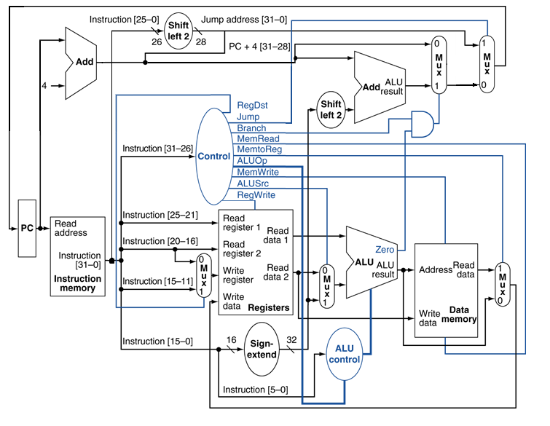
MIPS Single Cycle Datapath
Datapath elements
Addressing
PC Relative
Pseudodirect

Slide 9
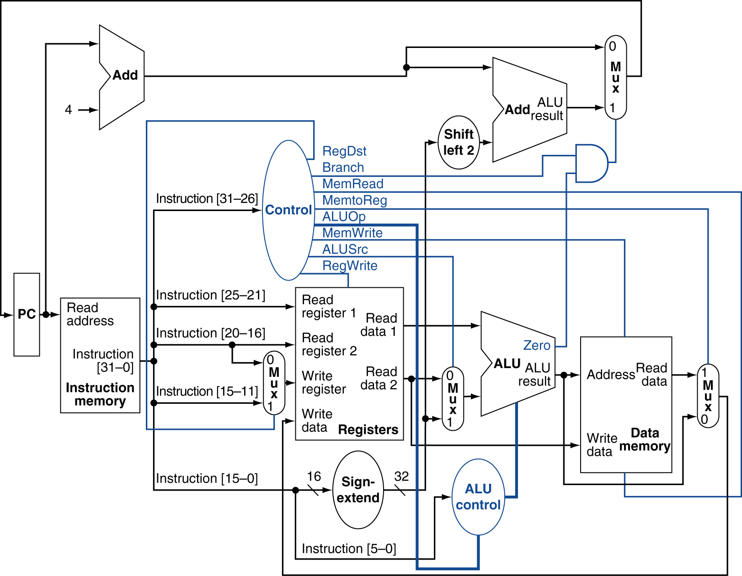
Sample Question
Explain how to derive the PC (program counter) for the instruction following a jump.

